Slide 1


Emma Pan – Individual Project 2
Emma Pan

Slide 2

CMS (Centers for Medicare & Medicaid Services)
U.S. government agency - Medicare, Medicaid, (CHIP) the Children’s Health Insurance Program, Health Insurance Marketplace
Notes:
U.S. government agency that oversee national healthcare programs
Includes Medicare, Medicaid, (CHIP) the Children’s Health Insurance Program, Health Insurance Marketplace

Slide 3
Problem
Do ownership types impact readmissions?
Do ownership types influence quality rankings?
Notes:
Because hospital ownership affects how hospitals operate —
their priorities, funding, and incentives. If ownership structure influences quality, it can have major implications for:
Patient Choice
If one ownership type consistently delivers better outcomes, patients can make more informed decisions about where to go for care.
If ownership type does not matter, that's also important — it means all hospital types support great care.
But if it does, your analysis helps identify where improvement is needed.

Slide 4
Data Collected
https://data.cms.gov/provider-data/?redirect=true
Easily download as csv

Slide 5
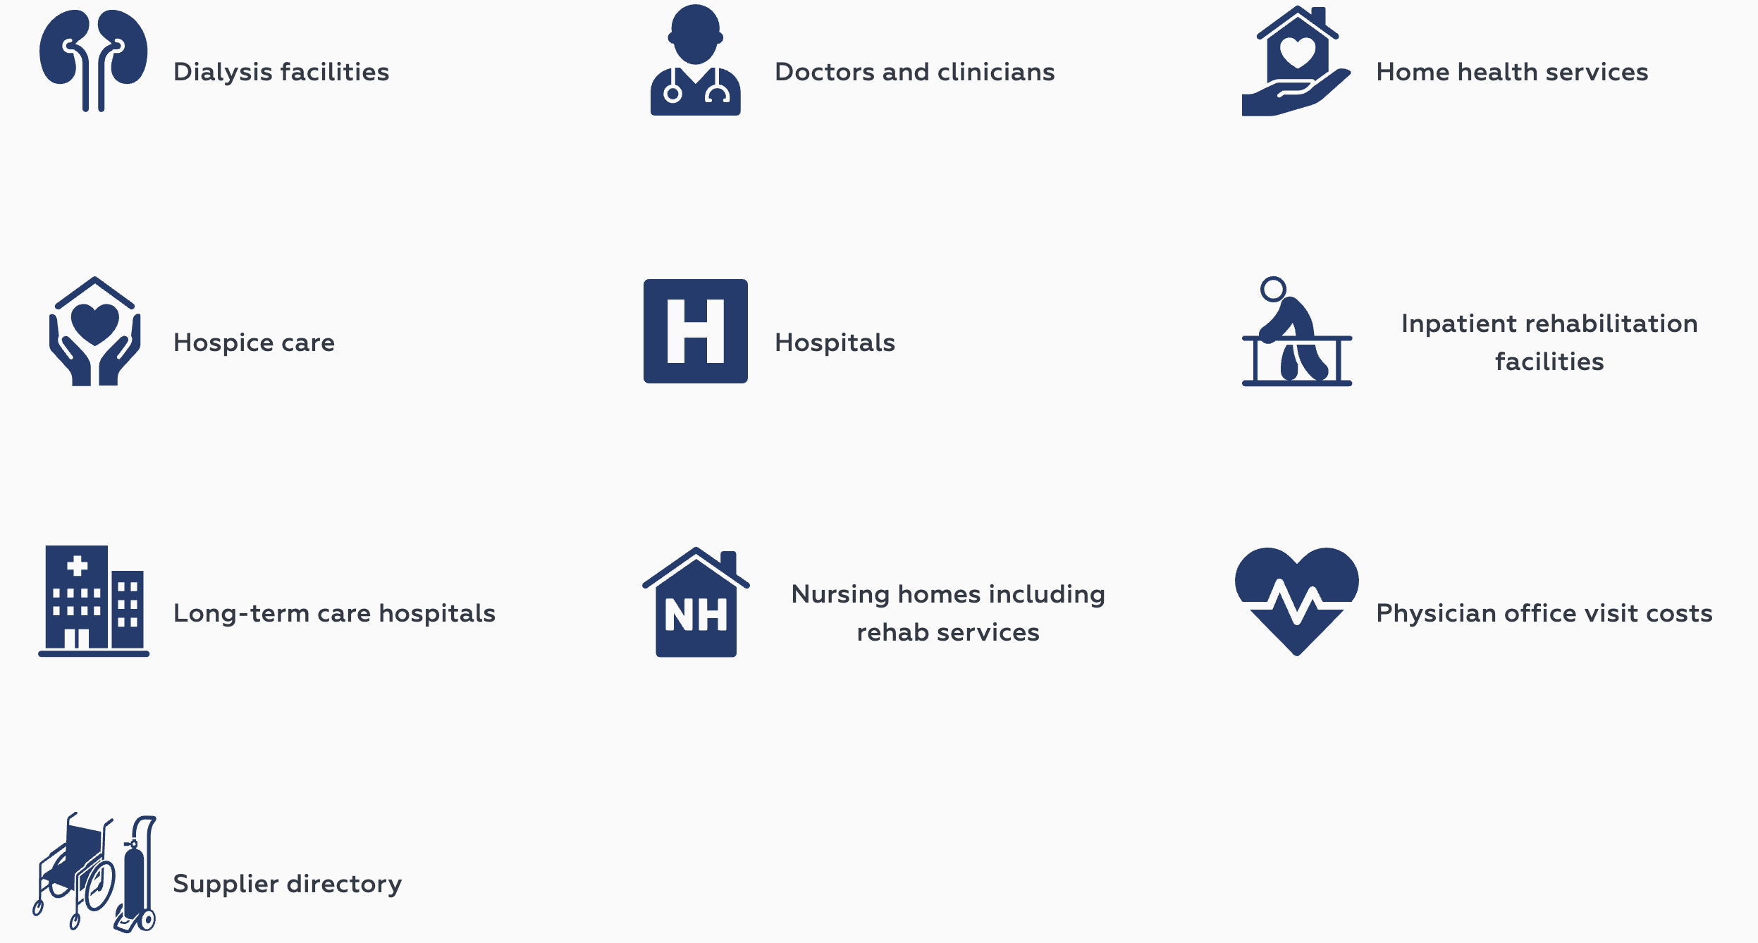
Data Overview
Data Collection and Ingestion (Source system)
Data Storage (databases and warehouses)
Data Processing and Cleaning
Data Warehousing and Analysis
Notes:
After we have some clear view about what CMS is and how it’s work, we can take a look at the overview data CMS has.
CMS has many different data related to their topics.
The picture here shows the main topics CMS has for their data.
We can see that CMS has variety of datasets that are related to healthcare providers, facilities, and performance metrics
Data source used by CMS primarily comes from multiple internal systems that manage claims processing, provider enrollment, patient records, and healthcare quality assessment
The data at CMS follows structured pipeline from data collection to storage, processing, and public access
Here’s an overview of Data flows through CMS
First is data collection and ingestion (source system)
Data is collected from hospital, providers, insurance claims, patient surveys, and state Medicaid agencies
Second data storage (databases and warehouses)
Data is stored in multiple relational databases, data lakes, and cloud-based warehouses
Data Processing and cleaning
Data is processed using ETL (extract, transform, load) pipelines
Lastly is data warehousing and analysis
Structured data is moved to CMS data warehouses for further analysis

Slide 6
DataSETs Used
Hospital General Information
HRRP (Hospital Readmissions Reduction Program) (readmission)
HVBP (Hospital Value-Based Purchasing – Person) (ranking system)
HCAHPS – Hospital (patient satisfaction by hospital ownership and overall hospital ratings)
Notes:
Use nurse communication data to see if it’s supported the claim we said

Slide 7
Datasets Used
Hospital General Information
HRRP (Hospital Readmissions Reduction Program) (readmission)
HVBP (Hospital Value-Based Purchasing – Person) (ranking system)
HCAHPS – Hospital (patient satisfaction by hospital ownership and overall hospital ratings)
Notes:
Hospital General Information
HRRP
I used Facility ID a lot in my code for merging different dataset together. Facility ID is the primary key for most of the dataset
I used Hospital Ownership and Excess Readmission Ratio from both dataset to analyze Readmission Rates by Hospital Ownership Type
I didn’t use address, phone, (or some detail about the hospital) since my analysis is based on the type of hospital not details for those hospitals
HVBP
I also use Facility ID for merging this dataset with Hospital General Information
I selected necessary columns for further analyzing
"Facility Name_x", "City/Town_x", "State_x", "Quality Score", "Rank” and "Avg Quality Score”
In order to see if different types of hospital ownership affect average quality score
HCAHPS
For this dataset, I’m looking for 'Patients who reported that their nurses "Always" communicated well’
In order to determine the relationship between nursing communication and patient satisfaction
I also use Facility ID for merging this dataset with Hospital General Information
My independent variable for this project are
Hospital Ownership
Nurse communication score
HCAHPS patient experience measures
Excess readmission ratio
My dependent variable for this project are
Hospital overall rating
Patient Satisfaction (HCAHPS scores)
Excess readmission ratio
I use google colab for my project since I can easily upload all the csv files to my google drive and linked to my colab
in order to easily do the analyze

Slide 8
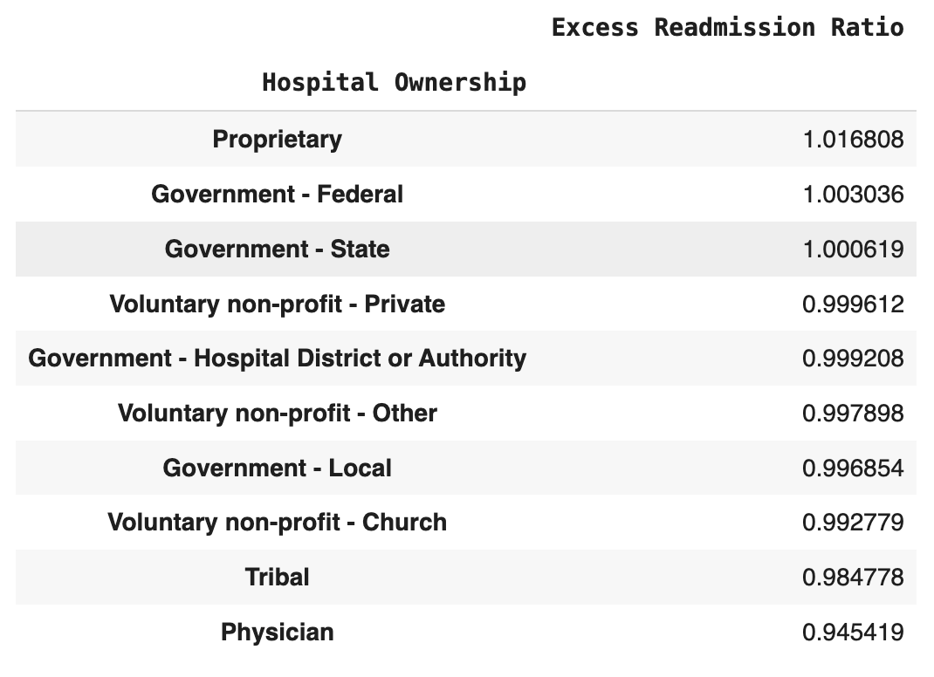
Ownership impacts Readmissions
Notes:
Import Hospital General Information and HRRP
merged both datasets with their facility ID (primary key)
Compare Readmission Rates by Hospital Ownership Type –
See if ownership (e.g., government, nonprofit, for-profit) impacts readmissions.
Proprietary and government hospitals have slightly better ratios than voluntary hospitals.
There is a slightly trend showing that non-profit hospitals perform better than for-profit
You can see that on the ratio for voluntary non-profit hospital and proprietary hospital.
Physician-owned and Tribal hospitals have the lowest averages (< 1.0), may indicating better outcomes since less patients return to the hospital

Slide 9
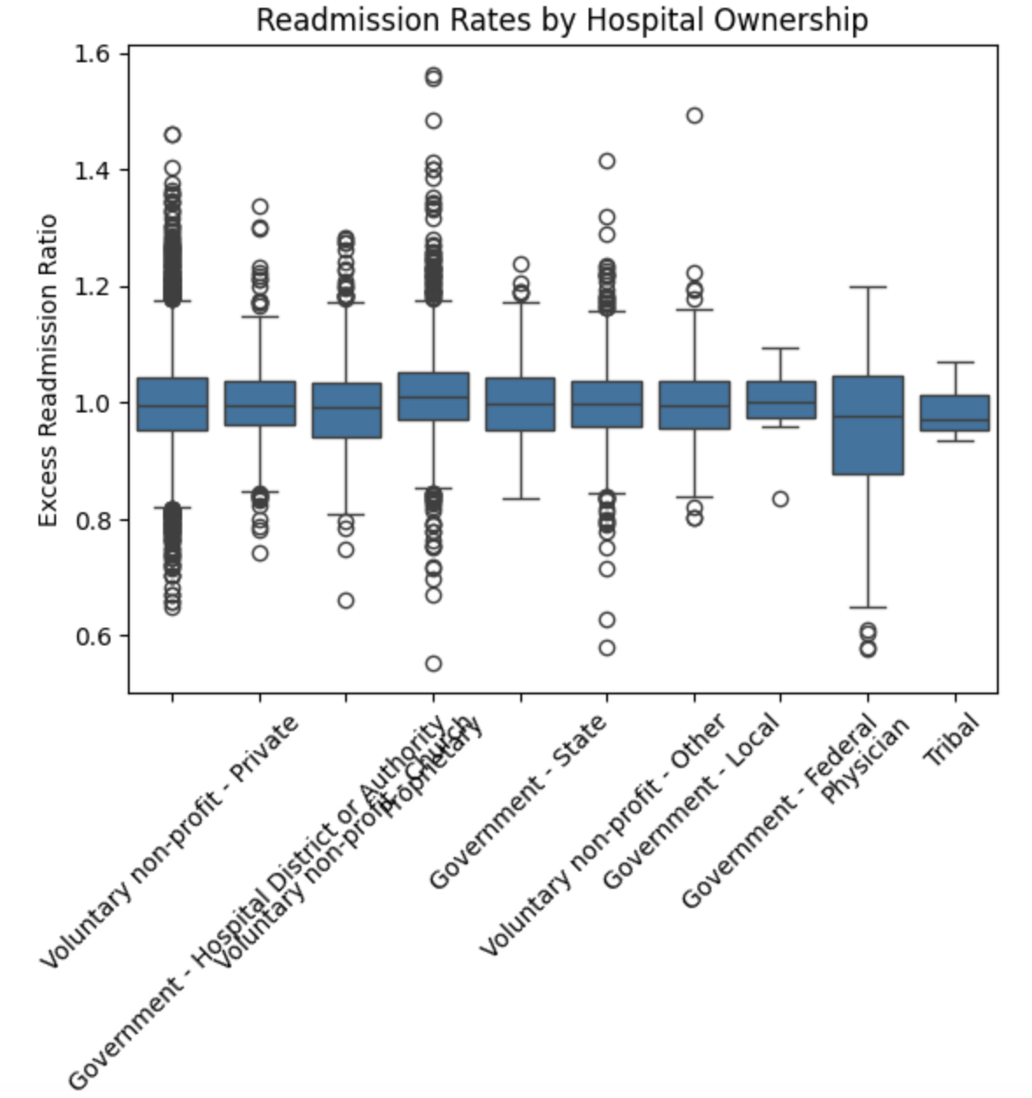
Ownership impacts Readmissions - Boxplot
Notes:
I got their means and created a boxplot
The middle line in each box is Median Readmission Ratio -> lower median means better average performance
Every column has a similar median, with tribal hospitals having the least,
meaning that tribal hospitals have better average performance.
We can also look at the size of the boxes
A narrower box means that the readmission ratios are more consistent
On the other hand, a wider box means there’s more variability
meaning that the hospitals in that group perform quite differently.
We can see that government-federal physicians have a wider box (possibly uneven quality of care or diverse facility types).

Slide 10
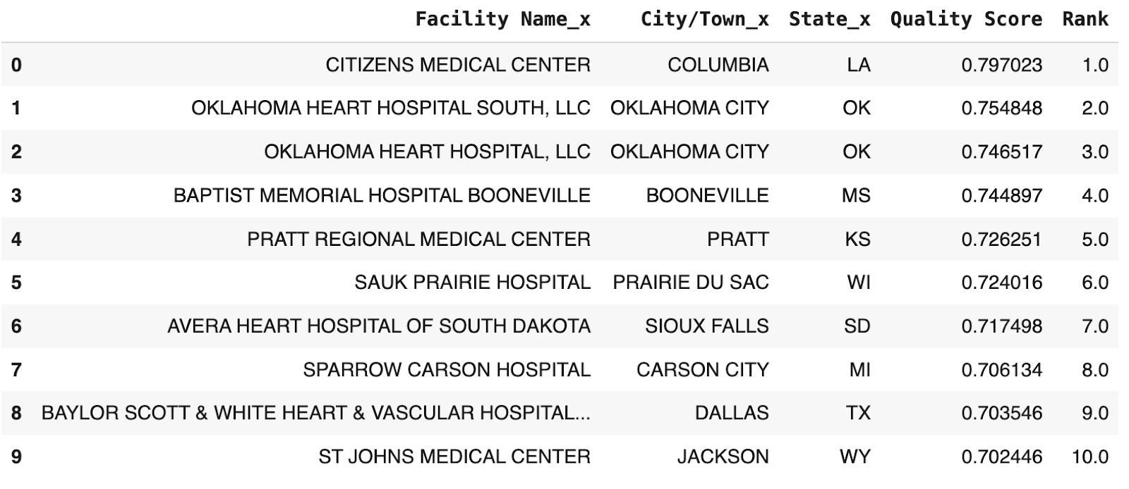
Hospital Quality Ranking System
Notes:
“Using a custom-weighted scoring system based on patient experience, communication, and performance rate metrics, I identified the top 10 hospitals across the U.S. in my dataset.
The results show a tight performance gap among top hospitals and a broad geographic spread, suggesting that excellence in care is not regionally limited.
The system effectively highlights consistently high-performing institutions and may support patients or policymakers in identifying quality care providers.”
Also, we see that Oklahoma City has 2 hospitals in the top 3, which is significant.

Slide 11
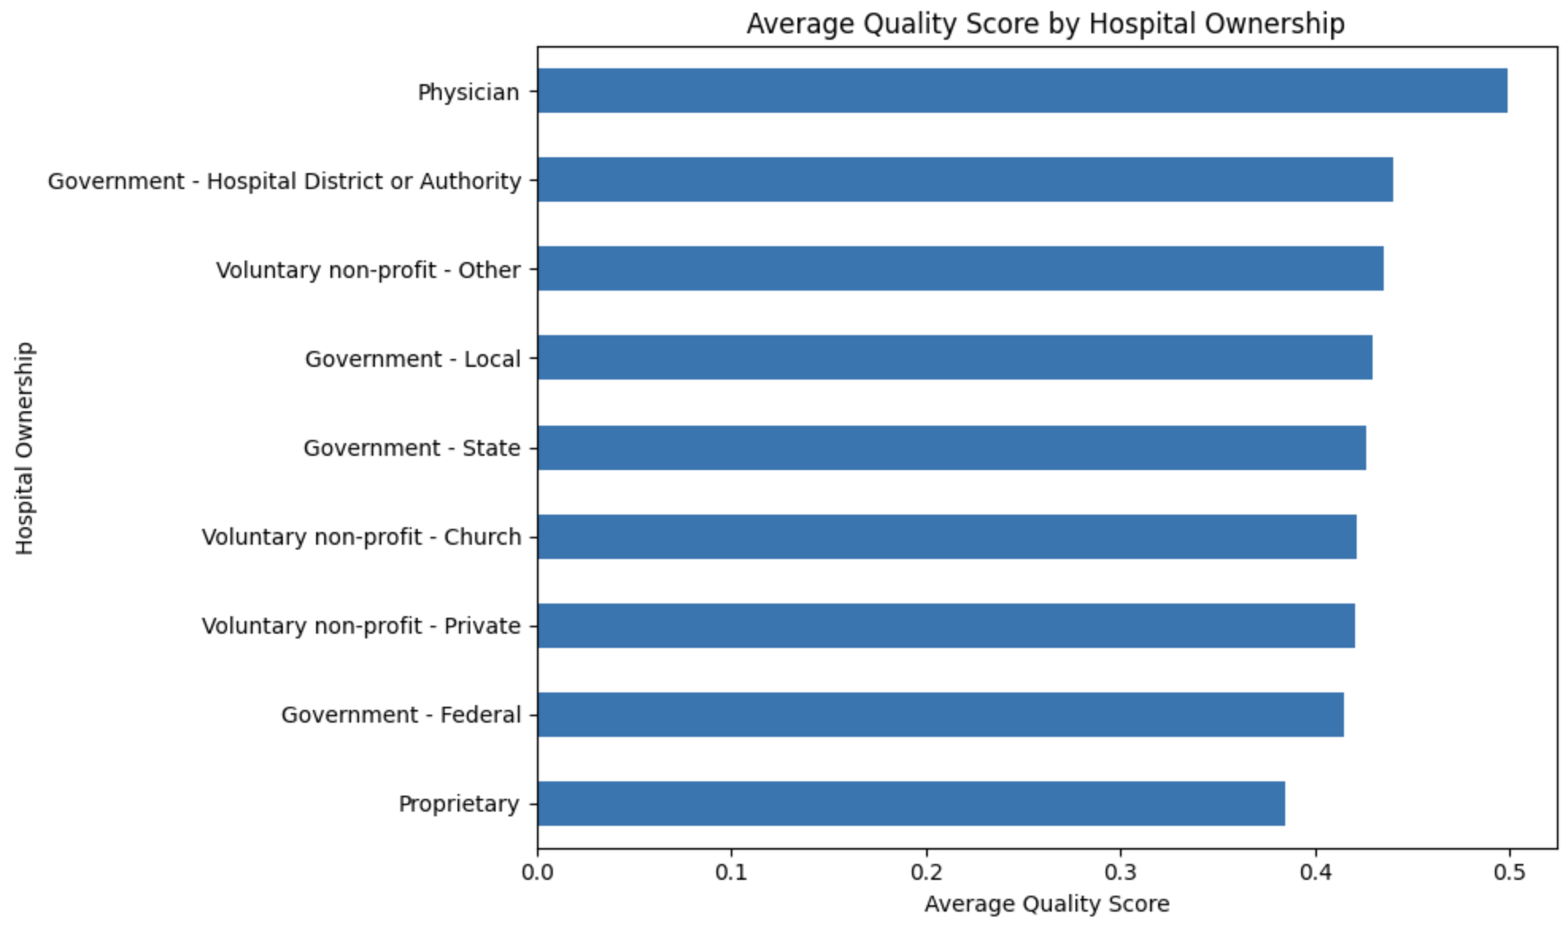
Combine Ownership and ranking
Notes:
Physician-Owned Hospitals Rank Highest
Highest average quality score
Implies better patient communication, experience, or performance in your weighted model.
Proprietary (For-Profit) Hospitals Rank Lowest
Consistently have the lowest average quality scores,
supporting common concerns about for-profit motives potentially affecting patient care quality.
Non-Profit and Government Hospitals Cluster in the Middle
Voluntary non-profit-private, government-state, and government-local show moderate performance
Suggests that while public and non-profit models vary,
they generally perform better than for-profits and worse than physician-owned.

Slide 12
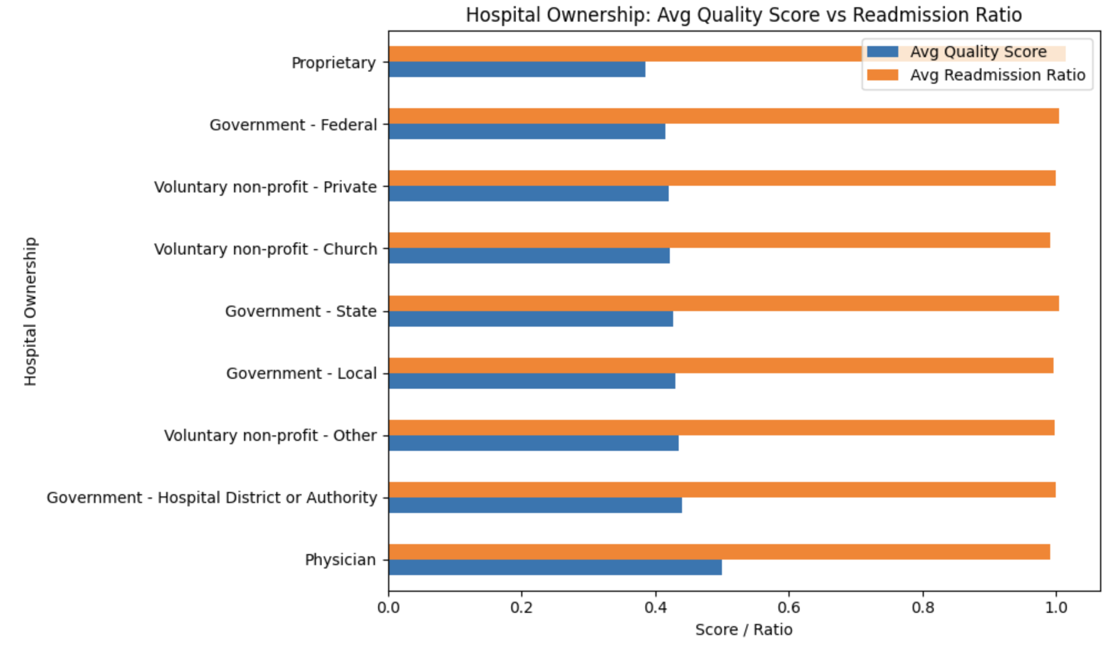
Combine readmission with quality score
Notes:
Physician-Owned Hospitals
Highest quality score and Lowest readmission ratio
Best performers overall. They dominate both metrics — suggesting focused, high-quality care.
Government - Hospital District / Authority
Strong quality score and Relatively low readmission
Well-balanced performance. Likely benefits from funding and regulation.
Voluntary Non-Profit
Moderate quality scores and Mid-to-low readmission ratios
Consistent and reliable
Proprietary (For-Profit) Hospitals
Lowest quality score and Highest readmission ratio
Lowest-performing group. Suggests cost-efficiency may come at the expense of quality and follow-up care.

Slide 13
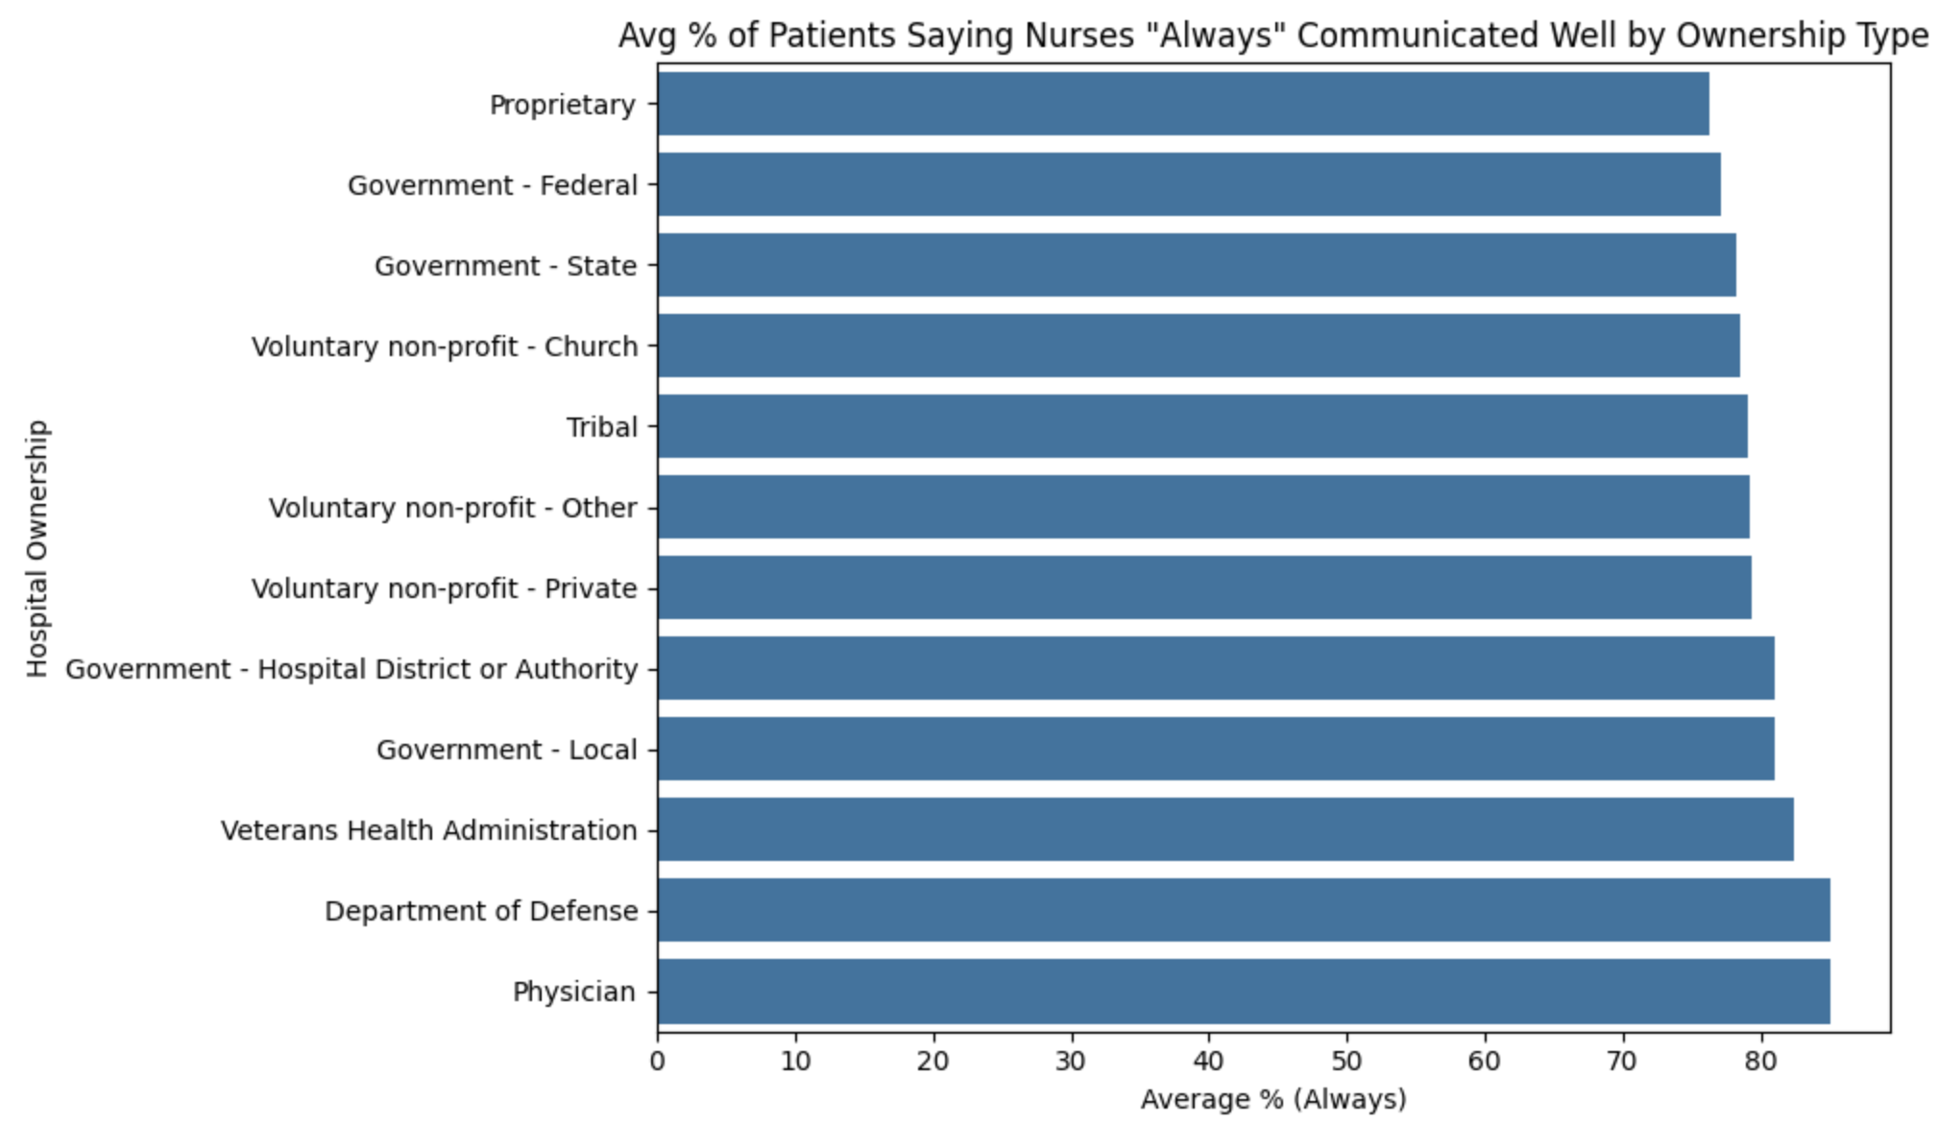
Compare patient satisfaction by hospital ownership across specific questions (not just overall rating)
Notes:
we previously showed that physician-owned and government-run hospitals (especially federal) ranked high in overall quality.
After seeing this graph, we can support that with strong nurse communication scores
→ a key contributor to satisfaction and trust.
Proprietary hospitals had worse readmission ratios.
we also see they have worse nurse communication, which is directly linked to:
Poor discharge understanding
Medication confusion
Increased likelihood of returning to the hospital
“Our analysis shows that nurse communication is a key driver of patient satisfaction
is highest in physician-owned, Department of Defense, and Veterans Health hospitals.
These ownership types also correlate with better overall quality scores and lower readmission rates.
In contrast, proprietary hospitals consistently underperform across all metrics,
raising questions about how ownership models impact communication and care delivery.”

Slide 14
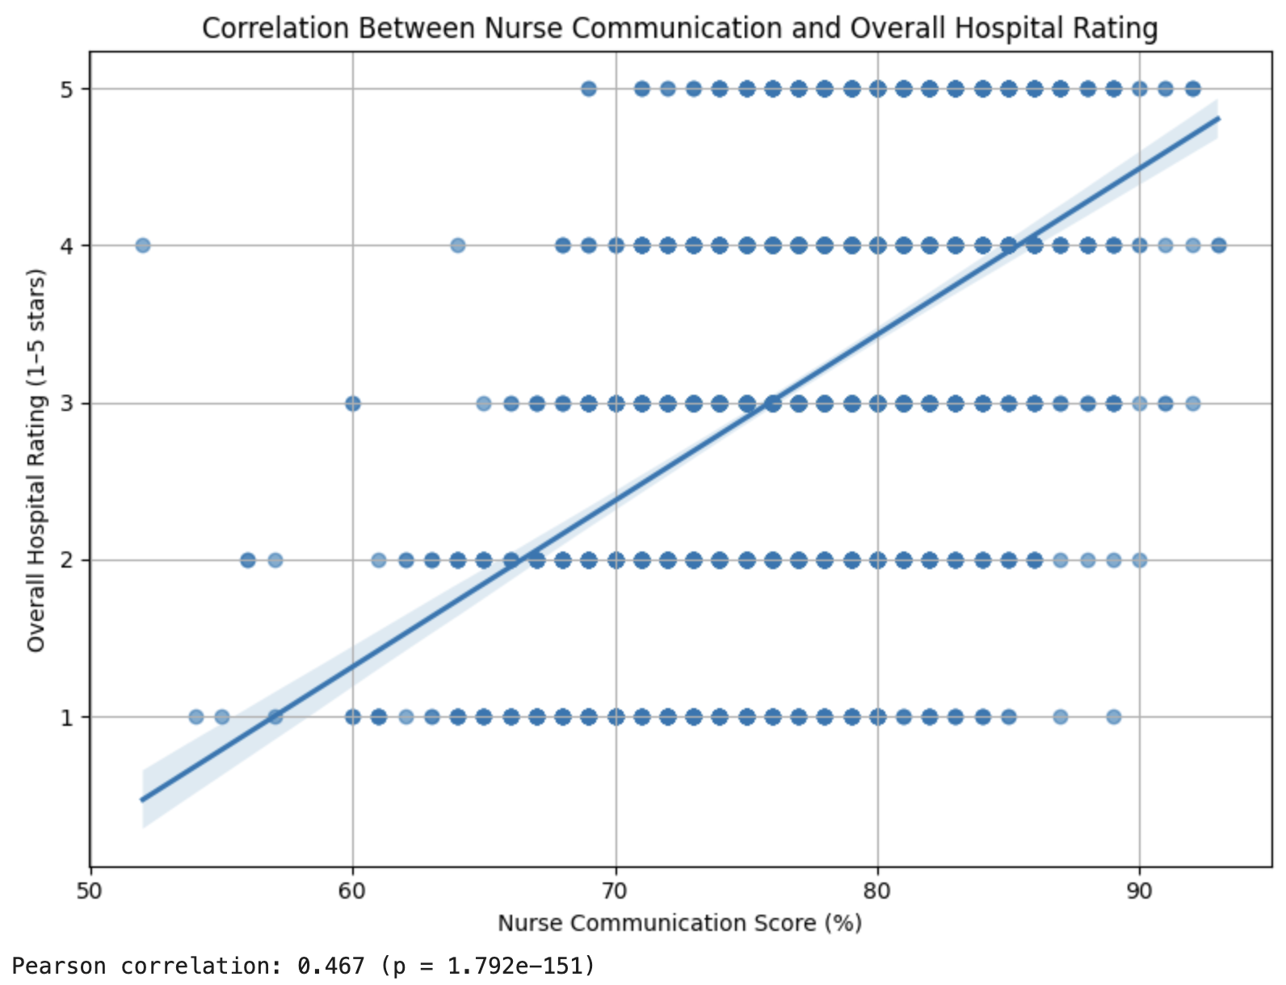
Correlate nurse communication with overall hospital ratings
Notes:
Regression Line Looks Valid
A positive correlation (closer to +1) means hospitals with better nurse communication tend to get higher ratings.
scatter plot with a regression line visually shows that relationship.
Dot Clusters at Discrete Values
My y-axis (overall hospital rating) has stacked dots at values 1, 2, 3, 4, 5 —
that’s correct because hospital ratings are discrete stars (1 to 5).
0.467 is a moderate-to-strong positive correlation.
The p-value is nearly 0, which means the result is highly statistically significant.
Hospitals with higher nurse communication scores tend to also have higher overall hospital ratings (on the 1–5 star scale).
Our analysis shows a clear, statistically significant positive relationship between how well nurses communicate and overall hospital ratings.
The Pearson correlation coefficient (r = 0.467, p < 0.001) suggests that as patient-reported nurse communication improves, overall hospital satisfaction increases.
This reinforces the importance of communication in shaping patients' perceptions of care quality.

Slide 15

Overall takeaways (Hospital)
Hospital Ownership Impacts Patient Experience
Nurse Communication Strongly Predicts Hospital Ratings
Readmission Rates Reflect Ownership Patterns
Notes:
Through our analysis of CMS HCAHPS patient survey data and hospital performance metrics,
we explored how hospital ownership, patient experience, and overall quality ratings relate to one another.
Here are some results that I found
1. Hospital Ownership Impacts Patient Experience
Physician-owned hospitals consistently scored highest across key patient experience measures —
particularly in nurse communication.
Proprietary (for-profit) hospitals had the lowest scores in both patient satisfaction and communication,
and also had higher excess readmission rates,
suggesting potential care quality concerns.
Government and non-profit hospitals ranked in the middle, but some types (e.g., Veterans Health) performed exceptionally well.
2. Nurse Communication Strongly Predicts Hospital Ratings
I found a statistically significant correlation (r = 0.467) between how well nurses communicate and a hospital’s overall rating.
This shows that positive patient-provider communication directly contributes to higher satisfaction and better perception of care.
3. Readmission Rates Reflect Ownership Patterns
Hospitals with better communication and higher quality scores also tended to have lower excess readmission ratios.
This supports the idea that engaged, informed patients are less likely to return unnecessarily,
emphasizing the value of good communication and discharge planning.
Takeaways
Hospital ownership and communication quality are not just administrative factors —
they directly shape how patients experience and evaluate care. Improving communication, especially between nurses and patients,
is a key strategy for enhancing satisfaction, reducing readmissions,
and boosting overall hospital performance.

